Slide 1
Upper position to run FPGA at 3V3. Lower position for 1.8V
Upper Position for USB,
Lower Position for External 5V
5 Jumpers fitted to supply power to the board

Slide 2
3V3 Rail
1V0 Rail
1V8 Rail

Slide 3
Jumper Positioning for External Programming

Slide 4
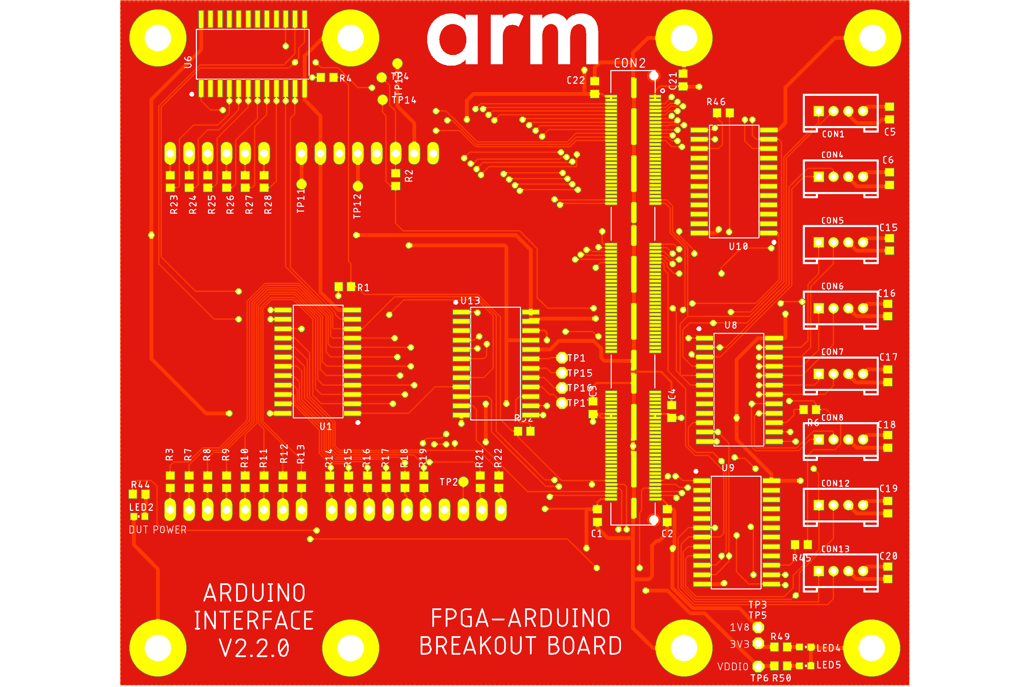
Arduino Breakout board
FPGA Board Interconnect
IO21
IO20
IO19
IO18
IO17
IO16
Arduino Form-Factor Pins (underside)
Grove connectors available for additional connectivity as required
(IO52 – IO64)
IO8
IO9
IO10
IO11
IO12
IO13
IO14
IO15
IO0
IO1
IO2
IO3
IO4
IO5
IO6
IO7

Slide 5
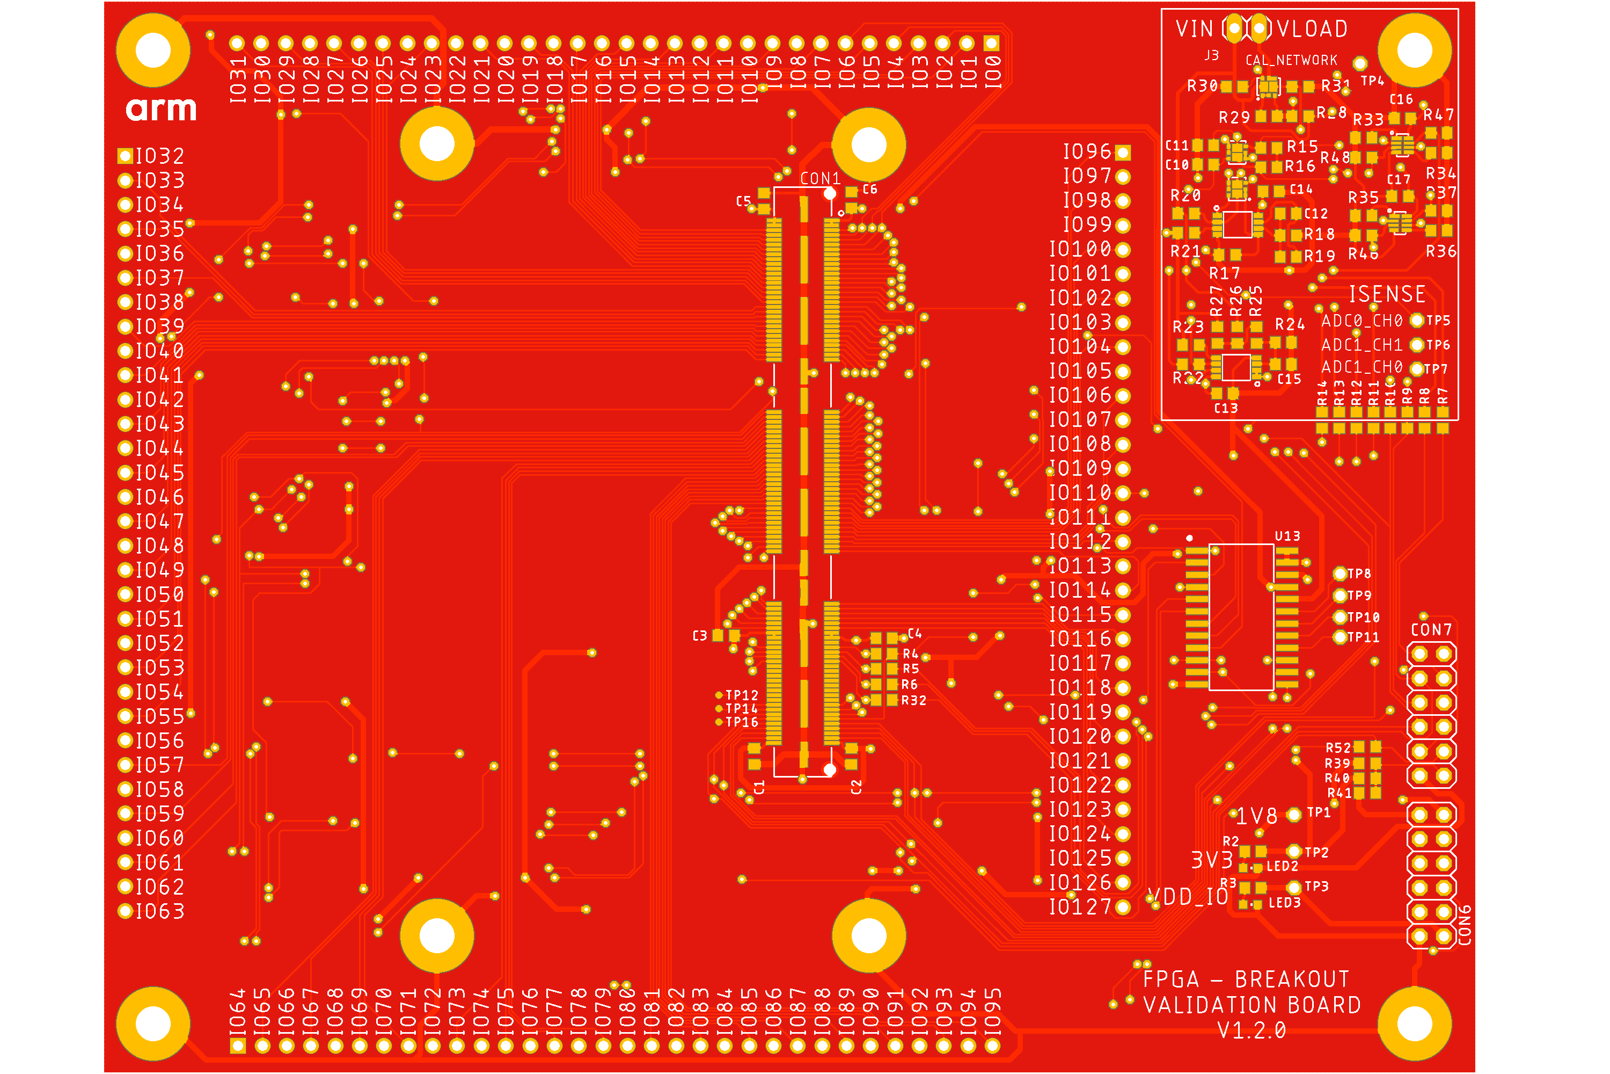
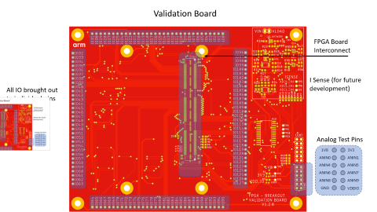
Validation Board
FPGA Board Interconnect
I Sense (for future development)
All IO brought out
to individual pins for monitoring and test
Analog Test Pins
1V8
3V3
ANIN0
ANIN1
ANIN4
ANIN5
ANIN6
ANIN7
ANIN8
ANIN9
GND
VDDIO

